Slide 1
Joint Sufficient Statistics and Minimal sufficient

Slide 2

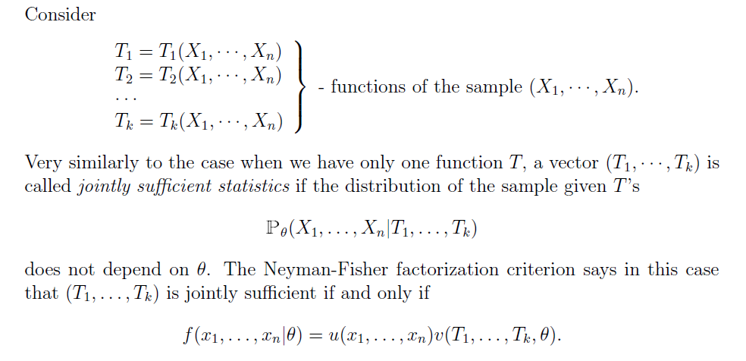

Slide 3
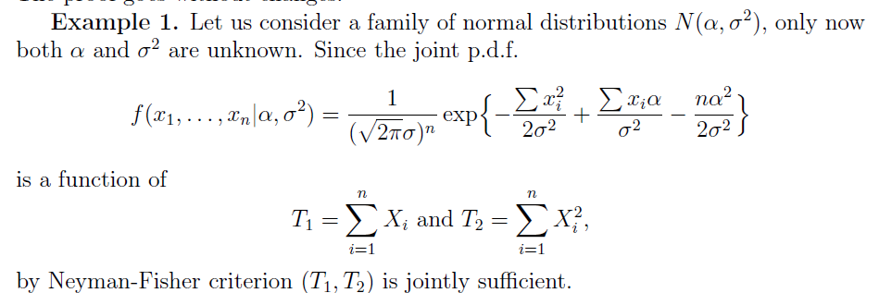

Slide 4
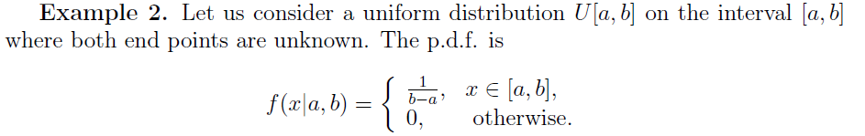
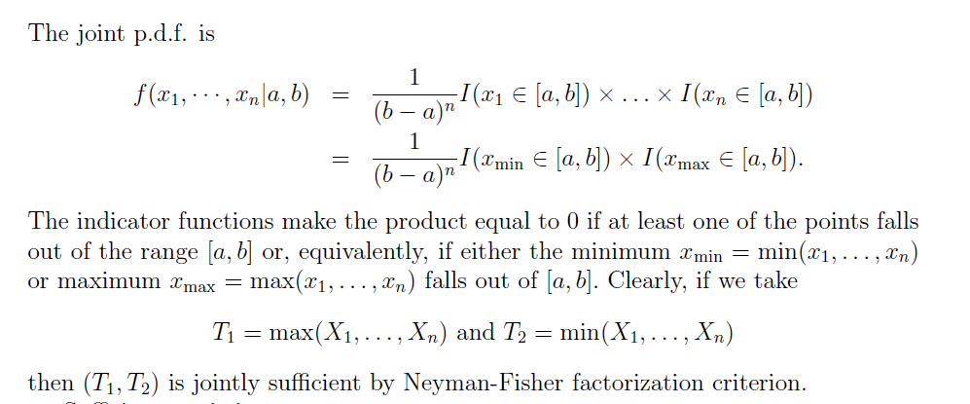

Slide 5
Importance of Sufficient Statistics
Gives a way of compressing information about underlying parameter θ.
Gives a way of improving estimator using sufficient statistic (application in Rao- Blackwell Theorem)

Slide 6


Slide 7
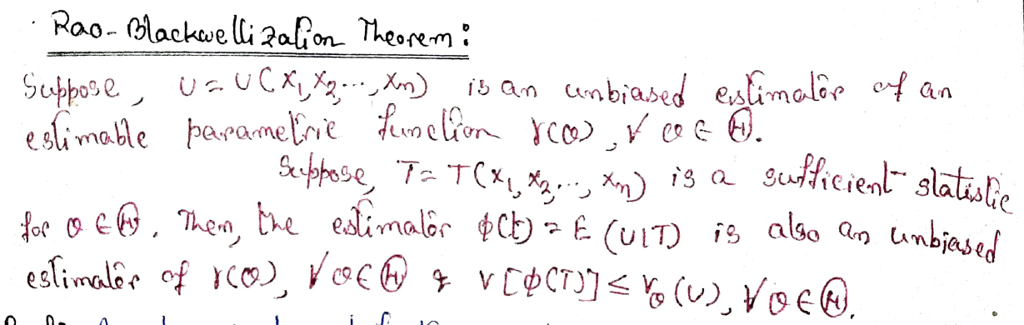

Slide 8
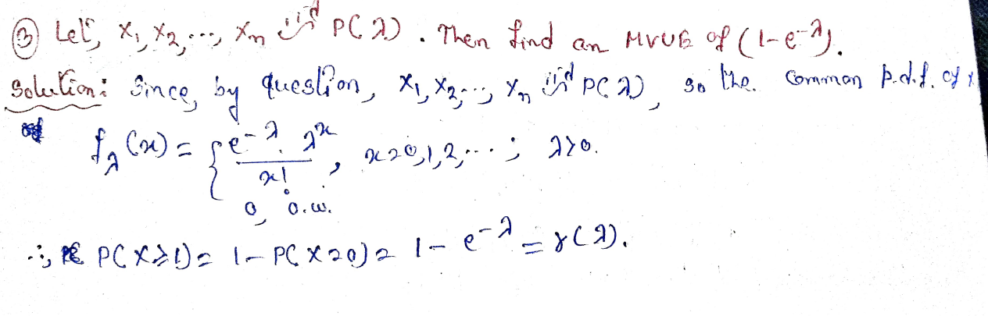

Slide 9
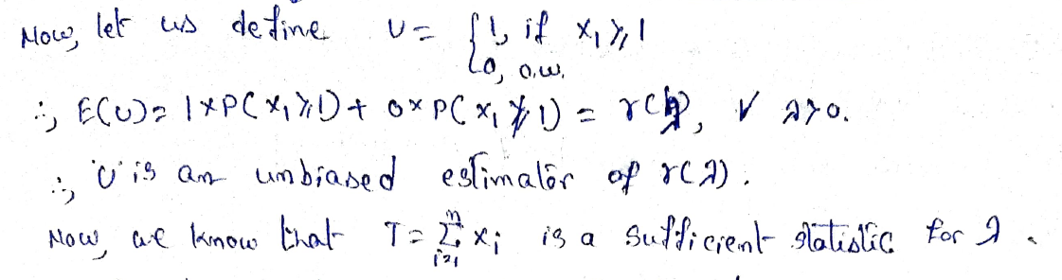
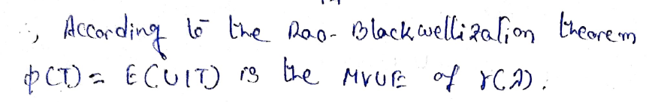

Slide 10
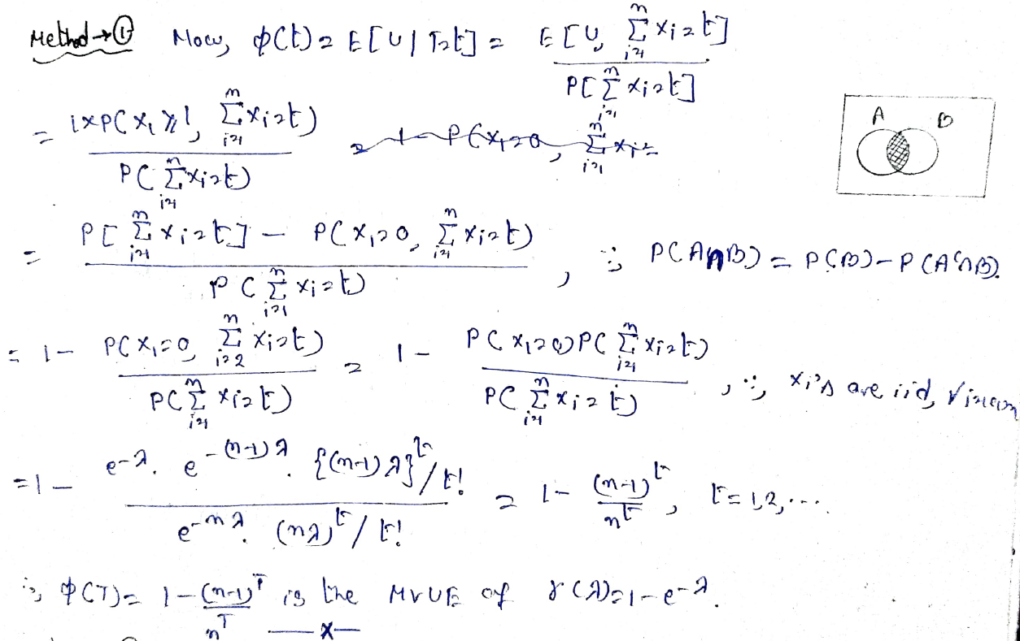

Slide 11
Minimal Sufficient Statistic
We are interested in finding a statistic that achieves the most data reduction while still retaining all the information about parameter θ.
Definition
A sufficient statistic T(X) is called a minimal sufficient statistic if, for any other sufficient statistic T′(X), T(x) is a function of T′(x).

Slide 12
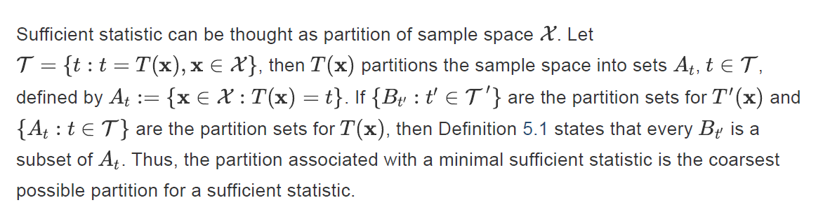

Slide 13
